Slide 1
Practice Problems
1. Design a circuit with a 4-bit BCD input A,B,C,D that produces an output W,X,Y,Z that is equal to the input +3 in binary. For example 9(1001)+3(0011)=12(1100). The output for BCD codes are don’t cares.

Slide 2
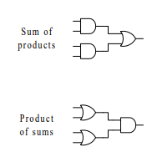
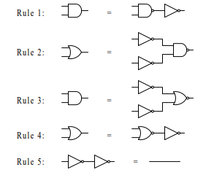
Technology mapping

Slide 3
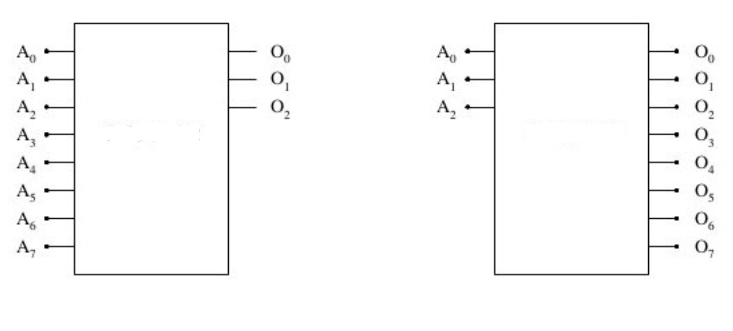
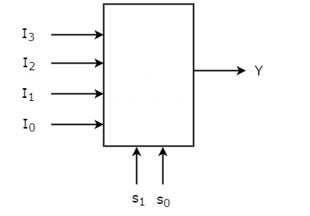
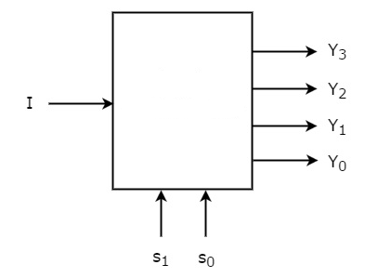

Slide 4
Draw a 4 to 10 line decoder using two 2 to 4 line decoder and 10 AND gates
Using one 3 to 8 line and one 1 to 2 line decoder.

Slide 5
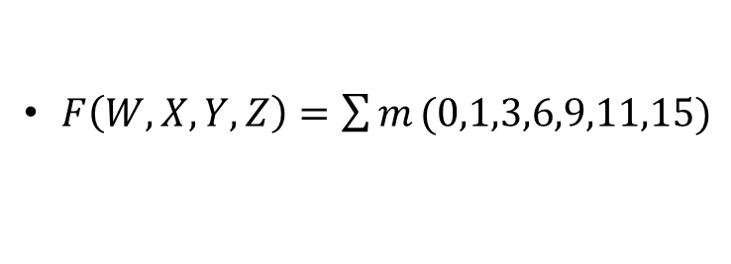
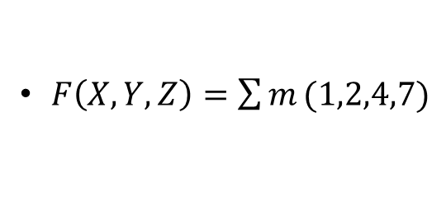


Design the circuit with a decoder and external OR gate
$F\left(X,Y,Z\right)=\sum{m}(1,2,4,7)$
$F\left(W,X,Y,Z\right)=\sum{m}(0,1,3,6,9,11,15)$
$F_{1}={AB}^{′}+BC$
$$F_{2}={(A+C)}^{′}+AB$$

Slide 6
